Slide 1
The Unjust Delay: Durga Datta Sharma vs. State
Subtitle

Slide 2
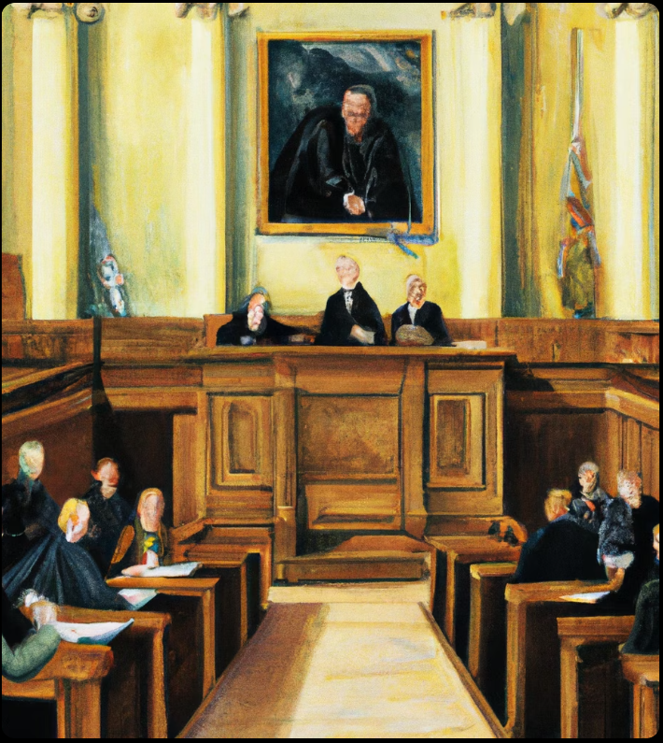
Introduction
In this case, FIR was filed in 1980 and charge sheet was submitted in 1985. Court held that petitioner was deprived of constitutional right of speedy trial.
Prosecution under Prevention of Corruption Act had not commenced after 25 years. No charges were framed, so court dropped all charges against accused.

Slide 3
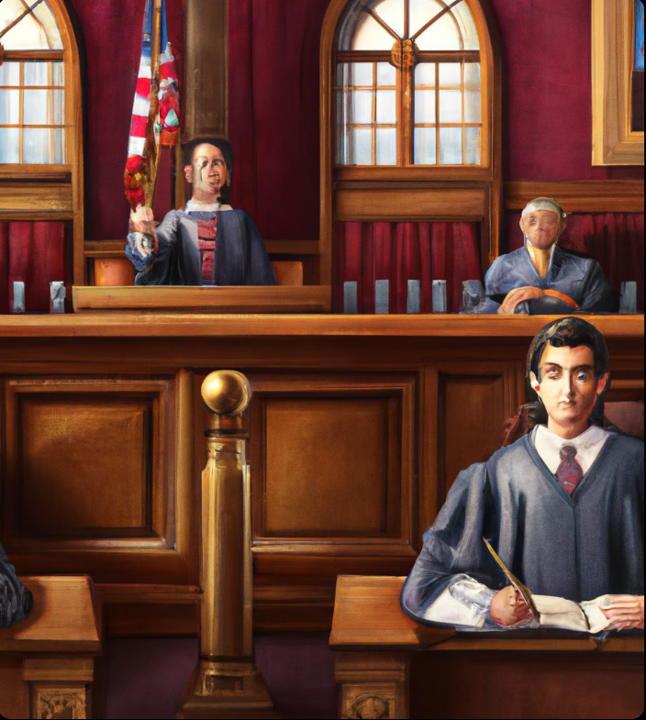
BACKGROUND
The case in question was of Durga Datta Sharma v. State. It was filed in the year 1980 and the charge sheet was submitted in the year 1985.The case was committed in 1991 and since the date of filing the FIR 14 years had elapsed for which the court held that the petitioner had been deprived for the constitutional right of getting a speedy trial.

Slide 4

Prosecution
The prosecution under the Prevention of Corruption Act had not commenced after 25 years. No charges had been framed and chances of commencing and concluding the trial soon were not strong.
Observing that the accused persons had already suffered a lot both mentally and physically during the last 25 years, the Court dropped all charges against the accused.

Slide 5

Ruling
The court held that the petitioner had been deprived for the constitutional right of getting a speedy trial. The prosecution under the Prevention of Corruption Act had not commenced after 25 years.Observing that the accused persons had already suffered a lot both mentally and physically during the last 25 years, the Court dropped all charges against the accused.

Slide 6
Conclusion
The case of Durga Datta Sharma v. State was a landmark case in the Indian legal system. The court held that the petitioner had been deprived of his constitutional right to a speedy trial.The court also observed that the accused persons had already suffered a lot both mentally and physically during the last 25 years. Therefore, the court dropped all charges against the accused.

Slide 7

Impact
The case of Durga Datta Sharma v. State had a lasting impact on the Indian legal system. It set a precedent that the right to a speedy trial must be respected.The court also made it clear that the accused should not be made to suffer mentally and physically for long periods of time due to delays in the trial process.

